Slide 1
Commerce Project
Group 4

Slide 2
Team Members
Harrison R. Lara – Project Manager, Architect
Daudi Williams – Technical Lead, QA
Madison Hubbard – Developer, QA

Slide 3
Purpose
The purpose of this web applications is to allow users to bank and use the services provided by Commerce Bank need a web application to manage their accounts, transactions and notifications.
This website will need to use all transactions for a user across several accounts the user has with the bank.
The user will also need to be able to customize and have a default set of notifications for transactions, time, dates, balances, etc.
The scope of this project is not limited to but consists of ensuring users will be able to login or register, then be redirected to their dashboard that allows them to see notifications and a snapshot of their accounts, export data and manage notifications.

Slide 4
Delivered by March 2, 2020 - Iteration 1
Set up the environment for the project
Creation of the login and the registration forms and pages
Creation of the user models, API’s, routes, and controllers
Styling of navigation, login and registration pages

Slide 5
Delivered by March 16, 2020 - Iteration 2
Adjusted the account and user models/controllers (back-end)
Created the dashboard
Display account balances on dashboard
Added routes for account detail pages
Created of the money market detail page
Created of the drawer for the navigation menu page
Documentation (iteration specific documentation, API documentation)
Created a technical prototype

Slide 6
Delivered by April 4, 2020 - Iteration 3
Creation of the savings detail page
Added to the money market detail page
Added the transaction amount got each account
Exported the account data into a spreadsheet
Added to the navigation slide menu page

Slide 7
Delivered by April 20, 2020 - Iteration 4
Created the checking account detail page
Added a way to add a new transaction to the checking acct page
Created display notifications on the dashboard page
Created the notification page, notification rules, notification component
Created the back-end for the notifications page
Created the dashboard notification icon and route to the page
Created the user guides and system guides
Fixed the bug in the side navigation page
Added the account detail page to the side navigation page
Added the transaction amount to the money market account and the savings account page

Slide 8
Delivered by May 4, 2020 - Iteration 5
Enhancement to User Session
Fixed a bug in Notifications
Added a Date Time Converter Utility
Made required changes from Commerce Feedback
Changed account detail page grids to have credit and debit columns
Created User Profile Page
Added input adornment to amount fields
Added conditional notifications to dashboard
Created logic for add, create, delete notifications
Added Number Formatter Utility

Slide 9
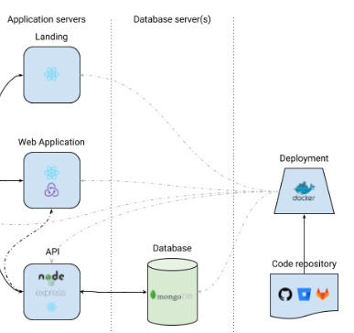
Architecture

